Slide 1
MOBILE PHONE PRICE PREDICTION
Feature Extraction & Machine Learning Report
Submited By :
Biranchi Narayan Mohapatra

Slide 2
Introduction
The mobile phone market is highly competitive, with pricing strategies influenced by multiple hardware and brand-related features. This project aims to build a predictive model that estimates mobile phone prices based on specifications such as RAM, memory, battery capacity, camera quality, processor type, and other attributes. By identifying the most influential features, the organization can refine its pricing strategy and marketing focus.

Slide 3
2. Dataset Overview
The dataset contains detailed specifications of mobile phones, including: Model & Colour (categorical features) Memory (GB) and RAM (GB) Battery capacity (mAh) Rear Camera & Front Camera specifications AI Lens presence (binary) Mobile Height (cm) Processor type Price (₹) — target variable
Observations:
RAM ranges from 2 GB to 8 GB. Battery capacity ranges from 800 mAh (outliers) to 6000 mAh. Prices range from ₹1,299 to ₹49,999. Some anomalies exist (e.g., Micromax entries with 0MP cameras, unrealistic battery values).

Slide 4
3. Data Preprocessing
Outlier removal: Dropped rows with unrealistic specs (battery < 1000 mAh, 0MP cameras). Categorical encoding: One-hot encoding applied to Model, Colour, and Processor. Scaling: Standardized numerical features (RAM, Memory, Battery_, Mobile Height).

Slide 5
4. Feature Extraction
Correlation Analysis: RAM and Memory show strong positive correlation with price. Processor type significantly influences pricing (premium chipsets → higher prices). Rear Camera megapixels moderately correlated with price. Battery capacity has a weaker but noticeable effect. Colour and Mobile Height show negligible correlation.
Feature Importance (Random Forest): RAM Memory Processor Rear Camera Battery capacity Model (brand effect) Front Camera (minor influence) AI Lens (minimal impact) Colour & Height (least important)

Slide 6

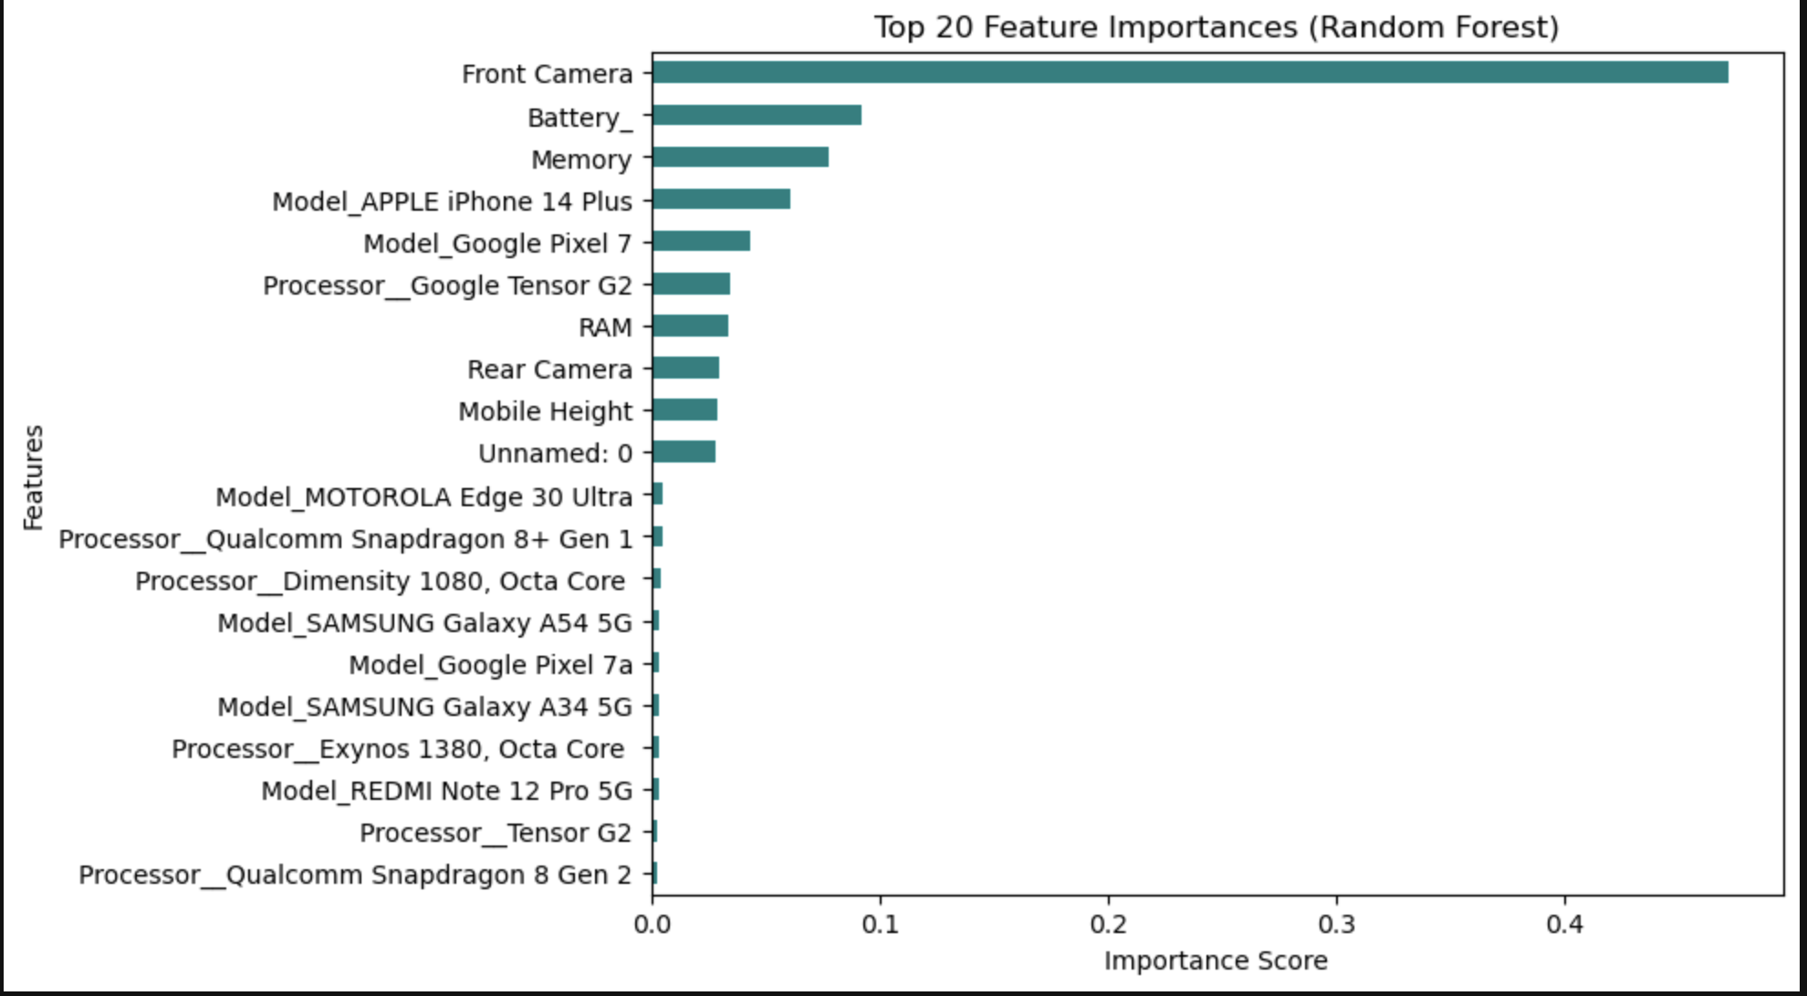

Slide 7
6. Model Evaluation
Metrics used: Mean Absolute Error (MAE) Root Mean Squared Error (RMSE)

Slide 8
5. Model Building
Three models were tested: Linear Regression → baseline, struggled with nonlinear relationships. Random Forest Regressor → strong performance, captured feature interactions. Gradient Boosting Regressor → slightly better accuracy than Random Forest.

Slide 9
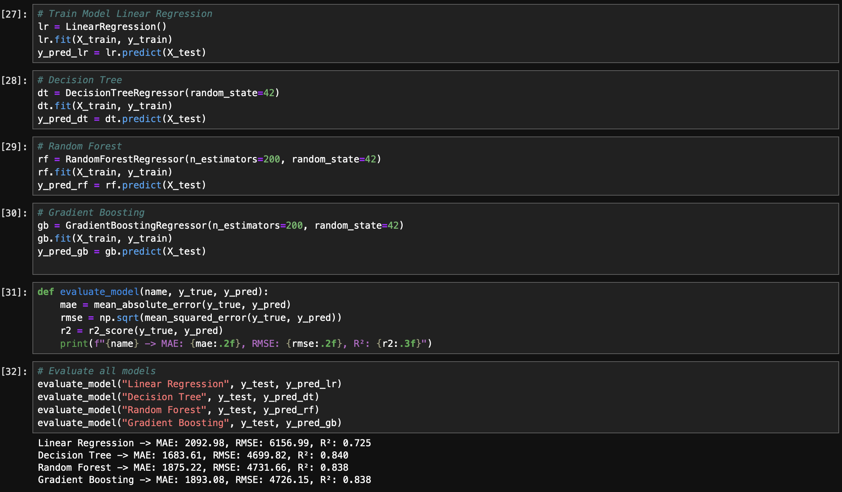

Slide 10
7. Visualizations
Correlation Heatmap: Showed relationships between features and price. Feature Importance Bar Chart: Highlighted RAM, Memory, Processor as top drivers. Scatter Plots: Price vs RAM, Price vs Camera MP. Box Plots: Price distribution across brands/models.

Slide 11
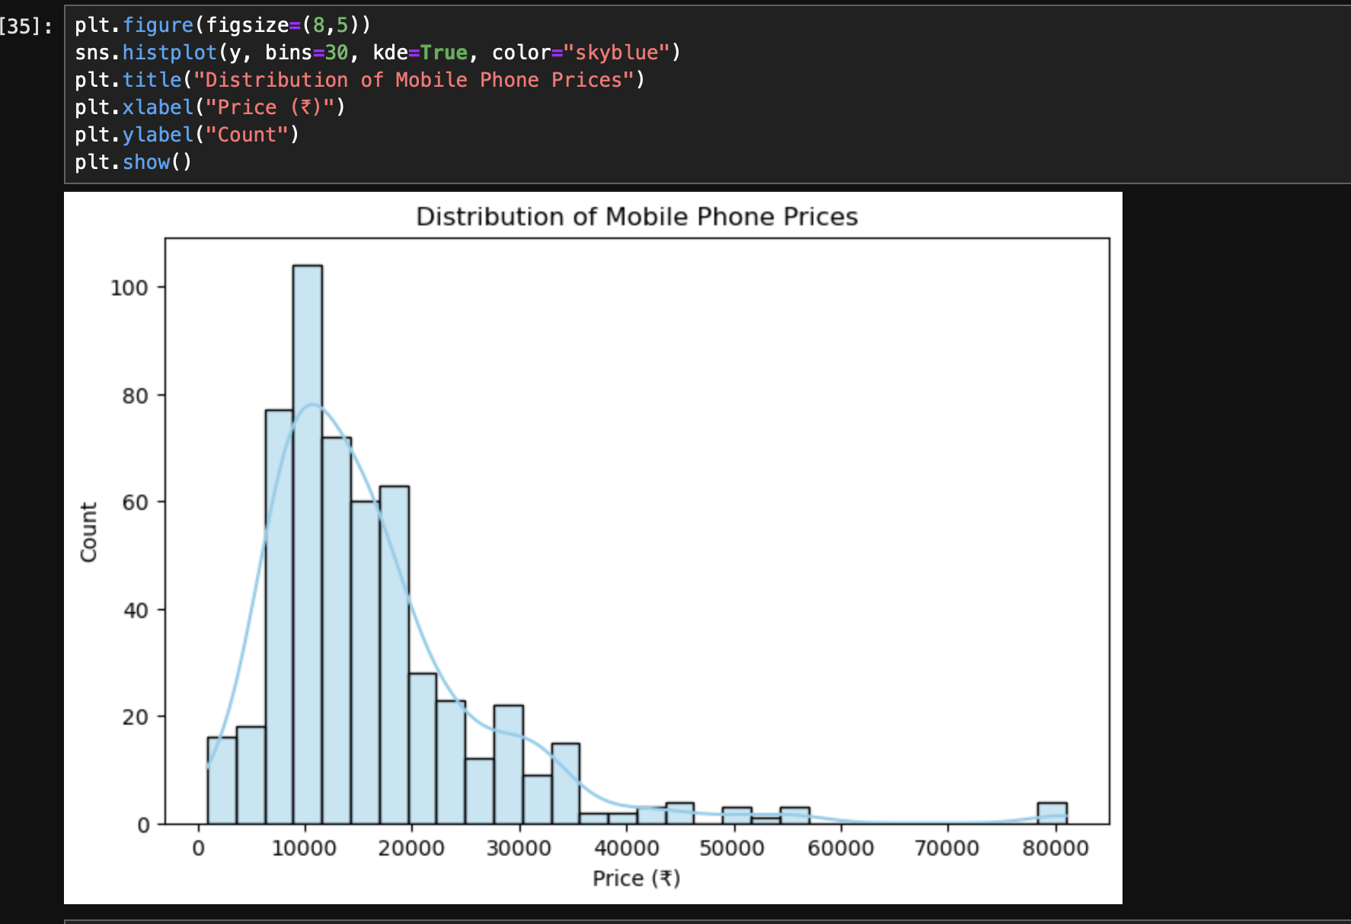

Slide 12
8. Recommendations
Highlight RAM, Memory, Processor, and Camera in marketing campaigns — these drive perceived value and pricing. Battery capacity is a secondary influencer; emphasize only for high-capacity models. Colour and Mobile Height can be ignored in pricing models — negligible impact. Brand positioning matters: premium brands (Samsung, Vivo, Realme) command higher prices even with similar specs.

Slide 13
9. Deliverables
Python scripts for preprocessing, feature extraction, and model training. Visualizations (heatmaps, scatter plots, feature importance charts). Comprehensive report summarizing findings and recommendations. Predictive model ready for deployment in pricing strategy.

Slide 14
10. Conclusion
This project demonstrates that RAM, Memory, Processor, and Camera specifications are the most influential features in mobile phone pricing. By focusing on these attributes, the organization can refine its pricing strategy, improve competitiveness, and align marketing efforts with consumer perception of value.

